Slide 1
Data Structures
Trees

Slide 2
Outline
Introduction to Trees
Binary Tree
Aplications
Tree Traversal
M-way Tree
Balanced Tree
Spanning Trees
Minimal Spanning Trees

Slide 3
Tree Data Structure
The Data Structures we have covered so far are Linear Data Structure
Tree data structure is a Non-linear Data Structure
Trees are mostly used to describe the hierarchy nature of data

Slide 4
Organizational Chart
Chairman
Faculty Members
Staff Members
Lab Incharge
AP
Lecturer
Lecturer
Jr. Lab Assistant
Technician
Naib Qasid
Dean
Sciences

Slide 5
Tree terminology
Nodes
Edges
If there are N nodes than at most n-1 edges
The root
Parent
Child
Sibling
Leaf
Degree

Slide 6
A
Root
B
C
D
E
F
G
H
I
J
K
L
M
N
O
P
Leaf Nodes

Slide 7
Tree
Tree contains no cycle
Unique path from root to any other node
A
Root
Path from A to M
A,B,G,M
A to J
A,D,J
B
C
D
E
F
G
H
I
J
P
K
L
M
NI
O
Leaf Nodes

Slide 8
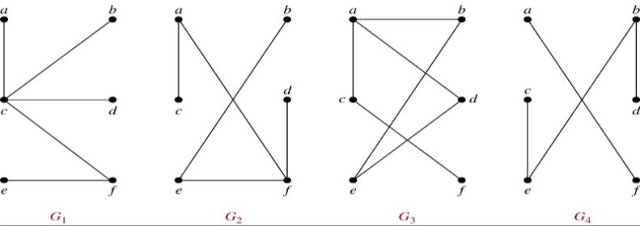
Trees
Def 1 A tree is a connected undirected graph with no simple circuits.
Example 1. Which of the graphs are trees?
Sol: G₁, G₂
Note. If connected condition is removed, it becomes forest

Slide 9
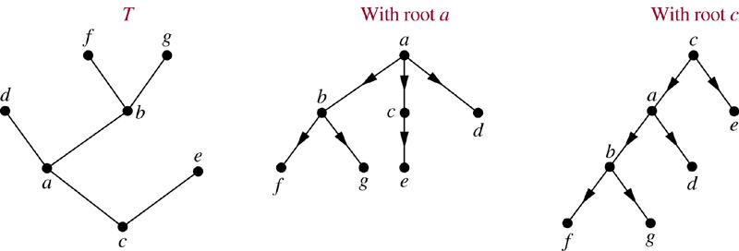
Thm 1. Any undirected graph is a tree if and only if there is a unique simple path between any two of its vertices.
Def 2. A rooted tree is a tree in which one vertex has been designed as the root and every edge is directed away from the root. (Arrow to disappear)
Example

Slide 10
Def: a is the parent of b, b is the child of a, c, d, e are siblings, a, b, d are ancestors of f c, d, e, f, g are descendants of b c, e, f, g are leaves of the tree (deg=1) a, b, d are internal vertices of the tree (at least one child) subtree with d as its root:
a
b
d
c
e
f
g
d
f
g
Def:
Vertices that have children are called internal vertices

Slide 11
Trees
Degree of a node:
The degree of a node is the number of children of that node
Degree of a Tree:
The degree of a tree is the maximum degree of nodes in a given tree
Path:
It is the sequence of consecutive edges from source node to destination node.
Height of a node:
The height of a node is the max path length form that node to a leaf node.
Height of a tree:
The height of a tree is the height of the root
Depth of a tree:
Depth of a tree is the max level of any leaf in the tree
11

Slide 12
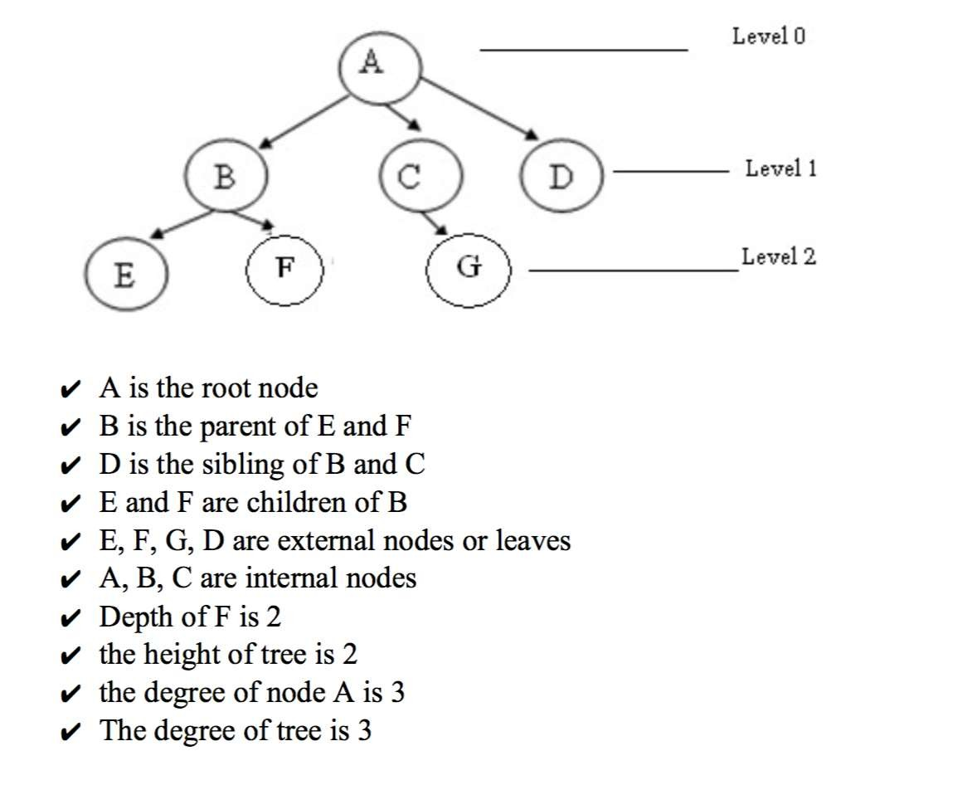

Slide 13
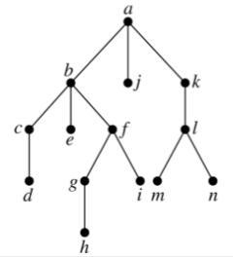
Def: The level of a vertex v in a rooted tree is the length of the unique path from the root to this vertex. The level of the root is defined to be zero. The height of a rooted tree is the maximum of the levels of vertices.
Example.
level
0
1
height = 4
2
3
4

Slide 14
Binary Tree
Every parent must have: 0≤children≤2
Very commonly used tree in computer sciences
Binary Search Tree - Used in many search applications where data is constantly entering/leaving
Syntax Tree - Constructed by compilers and (implicitly) calculators to parse expressions.
Huffman Coding Tree - used in compression algorithms, such as those used by the .jpeg and .mp3 file-formats.

Slide 15
Binary Tree
A Binary Tree is a finite set of elements that is either empty or is partitioned into three disjoint subsets
The first subset contains a single element called the Root of the tree
The other two subsets are themselves binary trees called:
Left Sub-trees
Right Sub-trees

Slide 16
A
Root
Left Sub tree
Right Sub tree
B
D
E
G
I
J
K
L
N
P

Slide 17
A
Root
B
D
Left Sub tree
Right Sub tree
E
G
I
J
K
L
N
P

Slide 18
A
B
D
Root
E
G
I
J
Left Sub tree
Right Sub tree
K
L
N
P

Slide 19
Strictly Binary Tree
A strictly binary tree has following property:
Every non-leaf node’s left and right sub-trees are non-empty

Slide 20
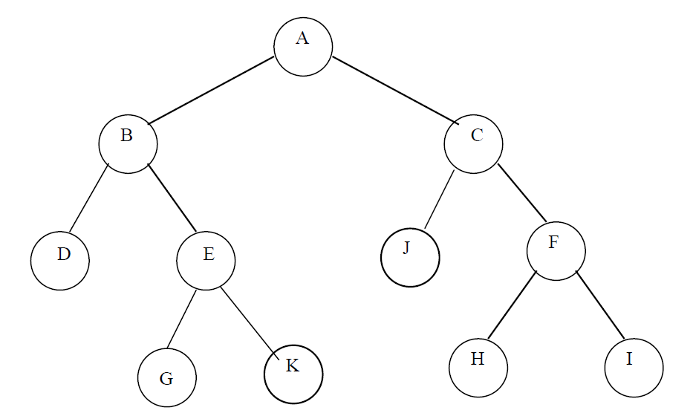
Strictly Binary Tree

Slide 21
Levels and Depth
Root has level 0,
Level of any other node is one more than the level its Parent
The depth of a binary tree is the maximum level of any leaf in the tree

Slide 22
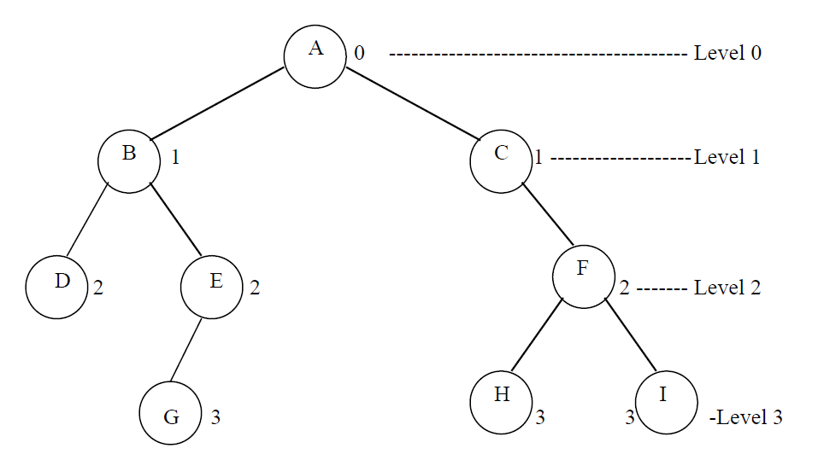
Levels and Depth

Slide 23
Complete Binary Tree
A Complete Binary Tree is of height d is a Strict Binary Tree whose all leaf nodes are at depth d

Slide 24
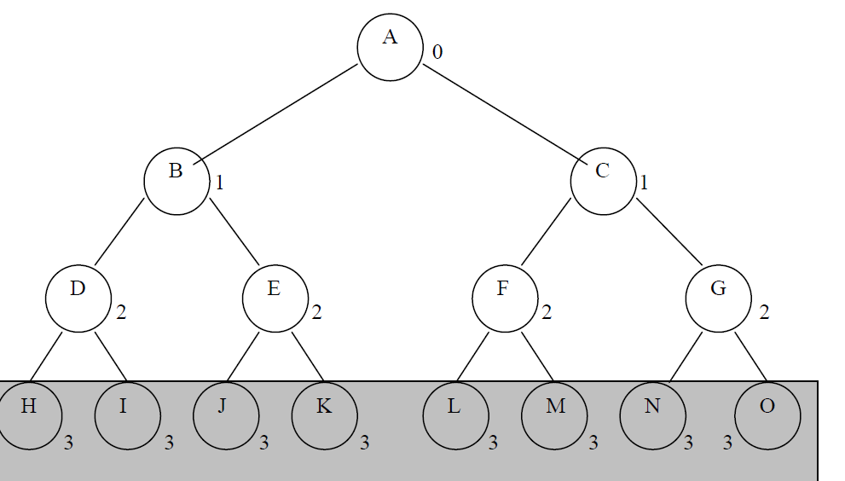
Complete Binary Tree

Slide 25
Complete Binary Tree
Complete Binary tree at a particular level n has 2^{n} nodes
A complete binary tree of depth d contain 2^{d} leaf nodes
2^{d} – 1 non-leaf (inner) nodes
Total no. of nodes = 2^{d+1} – 1

Slide 26
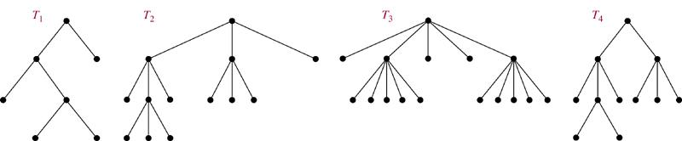
Def A rooted tree is called an m-ary tree if every internal vetex has no more than m children. The tree is called a full m-ary tree if every internal vertex has exactly m children. An m-ary tree with m=2 is called a binary tree.
Example
full binary tree
full 3-ary tree
full 5-ary tree
not full 3-ary tree

Slide 27
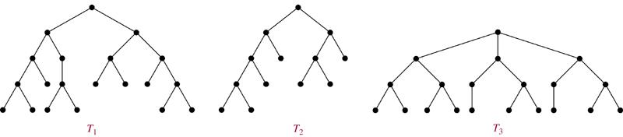
Def: A rooted m-ary tree of height h is balanced if all leaves are at levels h or h−1.
Example Which of the rooted trees shown below are balanced?
Sol. T₁, T₃
Thm 5. There are at most m^{h} leaves in an m-ary tree of height h.

Slide 28
Operations on the Binary Tree
Insertion
Deletion
Traversal
Search
Find Min
Find Max

Slide 29
Applications of Trees
Binary Search Trees
Decision Trees
Prefix Codes
Game Trees

Slide 30
Binary Search Tree
A Binary Search Tree BST also called an ordered or sorted binary tree ( with no duplicates) has the characteristic that:
The values in any left Subtree are less than the value in its parent
The value in any right Subtree are greater than the value in parent node

Slide 31
Binary Search Tree
47
25
77
11
43
65
93
7
31
44
68

Slide 32
Constructing Binary Search Tree
14, 15, 4, 9, 7, 18, 3, 5, 16, 20, 17

Slide 33
Constructing Binary Search Tree
14
14, 15, 4, 9, 7, 18, 3, 5, 16, 20, 17

Slide 34
Constructing Binary Search Tree
14
15
14, 15, 4, 9, 7, 18, 3, 5, 16, 20, 17

Slide 35
Constructing Binary Search Tree
14
15
14, 15, 4, 9, 7, 18, 3, 5, 16, 20, 17

Slide 36
Constructing Binary Search Tree
4
14
15
14, 15, 4, 9, 7, 18, 3, 5, 16, 20, 17

Slide 37
Constructing Binary Search Tree
14
4
15
14, 15, 4, 9, 7, 18, 3, 5, 16, 20, 17

Slide 38
Constructing Binary Search Tree
9
14
4
15
14, 15, 4, 9, 7, 18, 3, 5, 16, 20, 17

Slide 39
Constructing Binary Search Tree
14
4
15
9
14, 15, 4, 9, 7, 18, 3, 5, 16, 20, 17

Slide 40
Constructing Binary Search Tree
7
14
4
15
9
14, 15, 4, 9, 7, 18, 3, 5, 16, 20, 17

Slide 41
Constructing Binary Search Tree
14
4
15
9
7
14, 15, 4, 9, 7, 18, 3, 5, 16, 20, 17

Slide 42
Constructing Binary Search Tree
18
14
4
15
9
7
14, 15, 4, 9, 7, 18, 3, 5, 16, 20, 17

Slide 43
Constructing Binary Search Tree
14
4
15
9
18
7
14, 15, 4, 9, 7, 18, 3, 5, 16, 20, 17

Slide 44
Constructing Binary Search Tree
3
14
4
15
9
18
7
14, 15, 4, 9, 7, 18, 3, 5, 16, 20, 17

Slide 45
Constructing Binary Search Tree
14
4
15
3
9
18
7
14, 15, 4, 9, 7, 18, 3, 5, 16, 20, 17

Slide 46
Constructing Binary Search Tree
5
14
4
15
3
9
18
7
14, 15, 4, 9, 7, 18, 3, 5, 16, 20, 17

Slide 47
Constructing Binary Search Tree
14
4
15
3
9
18
7
5
14, 15, 4, 9, 7, 18, 3, 5, 16, 20, 17

Slide 48
Constructing Binary Search Tree
16
14
4
15
3
9
18
7
5
14, 15, 4, 9, 7, 18, 3, 5, 16, 20, 17

Slide 49
Constructing Binary Search Tree
14
4
15
3
9
18
7
16
5
14, 15, 4, 9, 7, 18, 3, 5, 16, 20, 17

Slide 50
Constructing Binary Search Tree
14
20
4
15
3
9
18
7
16
5
14, 15, 4, 9, 7, 18, 3, 5, 16, 20, 17

Slide 51
Constructing Binary Search Tree
14
4
15
3
9
18
7
16
20
5
14, 15, 4, 9, 7, 18, 3, 5, 16, 20, 17

Slide 52
Constructing Binary Search Tree
14
17
4
15
3
9
18
7
16
20
5
14, 15, 4, 9, 7, 18, 3, 5, 16, 20, 17

Slide 53
Constructing Binary Search Tree
14
4
15
3
9
18
7
16
20
5
17
14, 15, 4, 9, 7, 18, 3, 5, 16, 20, 17

Slide 54
Binary Search Trees
Goal: Implement a searching algorithm that finds items efficiently when the items are totally ordered.
Binary Search Tree: Binary tree + each child of a vertex is designed as a right or left child, and each vertex v is labeled with a key label(v), which is one of the items.
Note: label(v) > label(w) if w is in the left subtree of v and label(v) < label(w) if w is in the right subtree of v

Slide 55
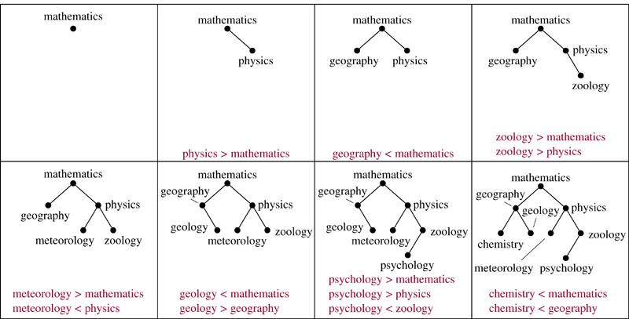
Example 1 Form a binary search tree for the words mathematics, physics, geography, zoology, meteorology, geology, psychology, and chemistry (using alphabetical order).
Sol.

Slide 56
Algorithm (Locating and Adding Items to a Binary Search Tree.)
Procedure insertion(T: binary search tree, x: item)
v := root of T
{a vertex not present in T has the value null}
while v ≠ null and label(v) ≠ x
begin
if x < label(v) then
if left child of v ≠ null then v:=left child of v else add new vertex as a left child of v and set v := null
else if right child of v ≠ null then v:= right child of v else add new vertex as a right child of v and set v := null
end
if root of T = null then add a vertex v to the tree and label it with x
else if v is null or label(v) ≠ x then label new vertex with x and let v be this new vertex
{v = location of x}

Slide 57
Example 2 Use Algorithm to insert the word oceanography into the binary search tree in Example 1.
Sol.
label(v) = mathematics < oceanography
mathematics
label(v) = physics > oceanography
v
label(v) = meteorology < oceanography
geography
physics
meteorology
zoology
chemistry
geology
oceanography
psychology

Slide 58
Tree Traversal
Systematically visiting each node of the tree
Three most famous tree traversal strategies:
In-Order Traversal
Pre-Order Traversal
Post-Order Traversal
Level order traversal is also used

Slide 59
Traversing a Binary Tree
Traversal
N
node
left subtree
right subtree
L
R
Preorder: (N,L,R)
Inorder: (L,N,R)
Postorder: (L,R,N)

Slide 60
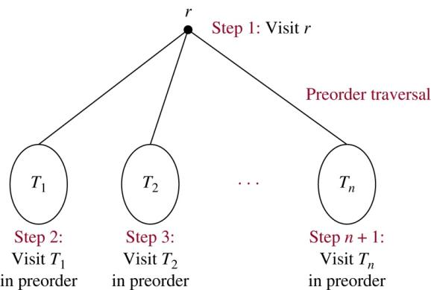
Traversal Algorithms
Preorder traversal (Depth-First Order)

Slide 61
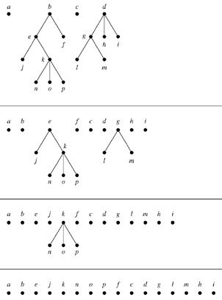
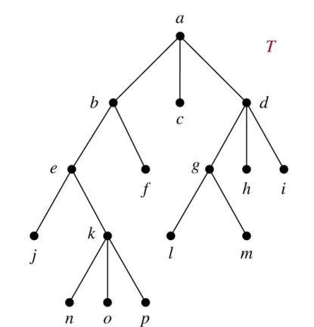
Example 2. In which order does a preorder traversal visit the vertices in the ordered rooted tree T shown below?
Sol:

Slide 62
Pre-Order Traversal
A
B
C
E
F
D
G
H
I
Pre-Order: A B D G C E H I F

Slide 63
Pre-Order Traversal
14
4
15
3
9
18
7
16
20
5
17
Pre-Order: 14 4 3 9 7 5 15 18 16 17 20

Slide 64
Algorithm 1 (Preorder Traversal)
Procedure preorder(T: ordered rooted tree)
r := root of T
list r
for each child c of r from left to right
begin
T(c) := subtree with c as its root
preorder(T(c))
end

Slide 65
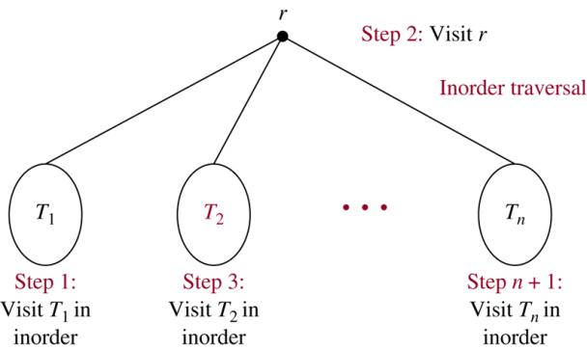
Inorder traversal(In the sequence)

Slide 66
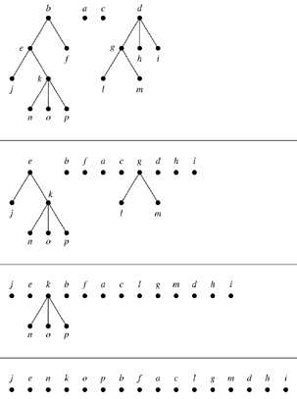
Example 3. In which order does a in-order traversal visit the vertices in the ordered rooted tree T shown below?
Sol:

Slide 67
In-Order Traversal
A
B
C
E
F
D
G
H
I
In-Order: D G B A H E I C F

Slide 68
In Order Traversal of a Binary Tree
14
4
15
3
9
18
7
16
20
5
17
In-Order: 3 4 5 7 9 14 15 16 17 18 20

Slide 69
Algorithm 2 (Inorder Traversal)
Procedure inorder(T: ordered rooted tree)
r := root of T
If r is a leaf then list r
else
begin
l := first child of r from left to right
T(l) := subtree with l as its root
inorder(T(l))
list r
for each child c of r except for l from left to right
T(c) := subtree with c as its root
inorder(T(c))
end

Slide 70
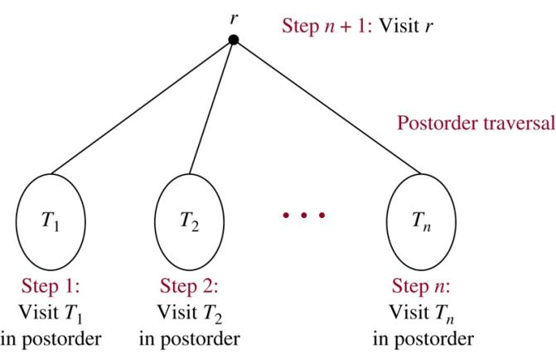
Postorder traversal

Slide 71
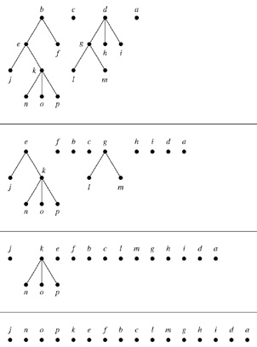
Example 4. In which order does a post-order traversal visit the vertices in the ordered rooted tree T shown below?
Sol:

Slide 72
Post-Order Traversal
A
B
C
E
F
D
G
H
I
Post-Order: G D B H I E F C A

Slide 73
Post order Traversal of a Binary Tree
14
4
15
3
9
18
7
16
20
5
17
Postorder: 3 5 7 9 4 17 16 20 18 15 14

Slide 74
Algorithm 3 (Postorder Traversal)
Procedure postorder(T: ordered rooted tree)
r := root of T
for each child c of r from left to right
begin
T(c) := subtree with c as its root
postorder(T(c))
end
list r

Slide 75
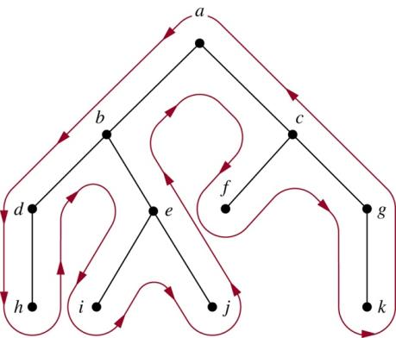
Easy representation: draw a red line around the ordered rooted tree
starting at the root, moving along the edges
Preorder: listing each vertex the first time this line passes it
Inorder: listing a leaf the first time the line passes it and listing
each internal vertex the second time the line passes it
Postorder: listing a vertex the last time it is passed on the way back up
to its parent
Preorder: a, b, d, h, e, i, j, c, f, g, k
Inorder: h, d, b, i, e, j, a, f, c, k, g
Postorder: h, d, i, j, e, b, f, k, g, c, a

Slide 76
Pre-Order Expression Tree Traversal
(a+b*c)+((d*e+f)*g)
+
+
*
a
*
+
g
*
b
c
f
d
e
Pre-Order: + + a * b c * + * d e f g

Slide 77
Post Order Expression Tree Traversal
(a+b*c)+((d*e+f)*g)
+
+
*
a
*
+
g
*
b
c
f
d
e
Post-Order: a b c * + d e * f + g * +

Slide 78
In order Expression Tree Traversal
(a+b*c)+((d*e+f)*g)
+
+
*
a
*
+
g
*
b
c
f
d
e
In-Order: a + b * c + d * e + f * g

Slide 79
Level-Order Traversal
A
B
C
E
F
D
G
H
I
Level-Order: A

Slide 80
Level-Order Traversal
A
B
C
E
F
D
G
H
I
Level-Order: A B C

Slide 81
Level-Order Traversal
A
B
C
E
F
D
G
H
I
Level-Order: A B C D E F

Slide 82
Level-Order Traversal
A
B
C
E
F
D
G
H
I
Level-Order: A B C D E F G H I

Slide 83
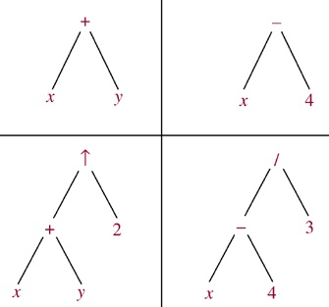
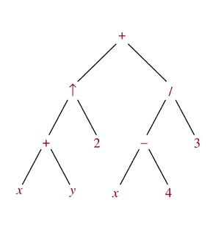
Infix, Prefix, and Postfix Notation
We can represent complicated expressions, such as compound propositions, combinations of sets, and arithmetic expressions using ordered rooted trees.
Example 1 Find the ordered rooted tree for ((x+y)↑2)+((x−4)/3).
Sol.
leaf: variable internal vertex: operation on its left and right subtrees

Slide 84
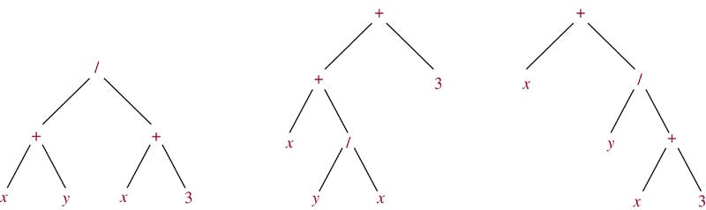
The following binary trees represent the expressions: (x+y)/(x+3), (x+(y/x))+3, x+(y/(x+3)). All their inorder traversals lead to x+y/x+3 ⇒ ambiguous ⇒ need parentheses
Infix form: An expression obtained when we traverse its rooted tree with inorder. Prefix form: … … by preorder. (also named Polish notation) Postfix form: … … by postorder. (reverse Polish notation)

Slide 85
Example What is the prefix form for ((x+y)↑2)+((x−4)/3)?
Sol.
+ ↑ + x y 2 / − x 4 3
Example 8 What is the postfix form of the expression ((x+y)↑2)+((x−4)/3)?
Sol.
x y + 2 ↑ x 4 − 3 / +
Note. An expression in prefix form or postfix form is unambiguous, so no parentheses are needed.

Slide 86
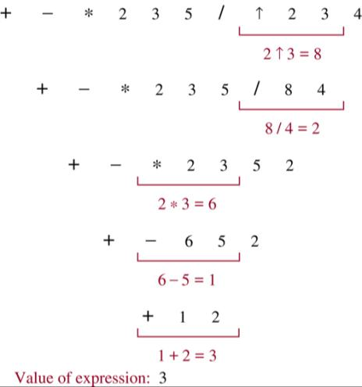
Example What is the value of the prefix expression + − * 2 3 5 / ↑ 2 3 4?
Sol.
Operation from right to left, First sign of operation (For example, ↑) The two figures on the right doing this operation, Results in original place, And so on.

Slide 87
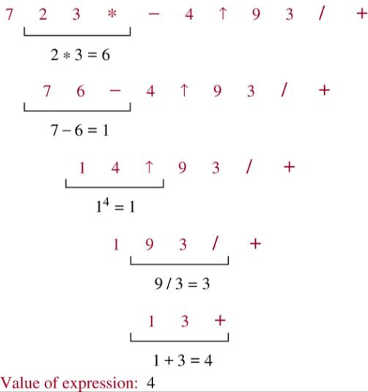
Example What is the value of the postfix expression 7 2 3 * − 4 ↑ 9 3 / +?
Sol.
Operations from left to right, First sign of operation (For example, *) Two numbers on the left of this operation, Result replaces the original location, and so on.

Slide 88
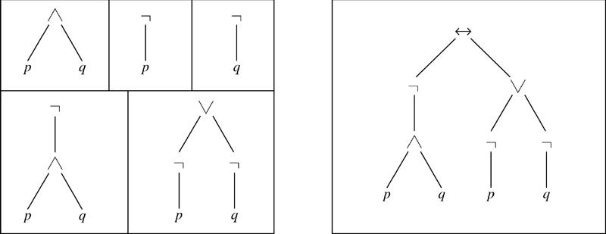
Example Find the ordered rooted tree representing the compound proposition (¬(p∧q)) ↔ (¬p∨¬q). Then use this rooted tree to find the prefix, postfix, and infix forms of this expression.
Sol.
prefix: ↔ ¬ ∧ p q ∨ ¬ p ¬ q
infix: (¬(p∧q)) ↔ ((¬p)∨(¬q))
postfix: p q ∧ ¬ p ¬ q ¬ ∨ ↔

